Slide 1
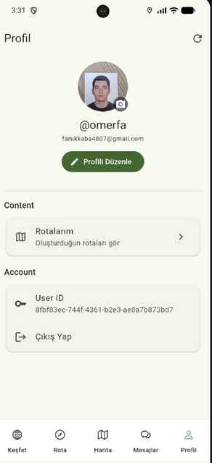

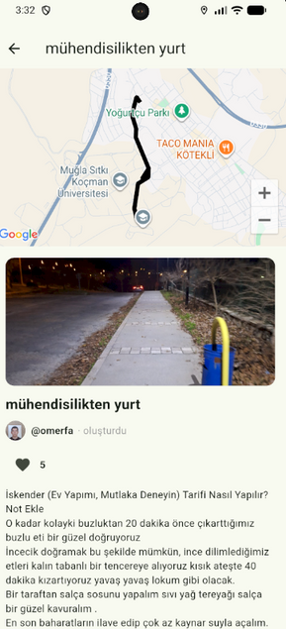
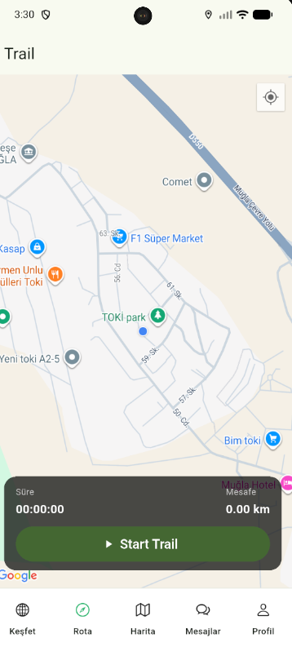
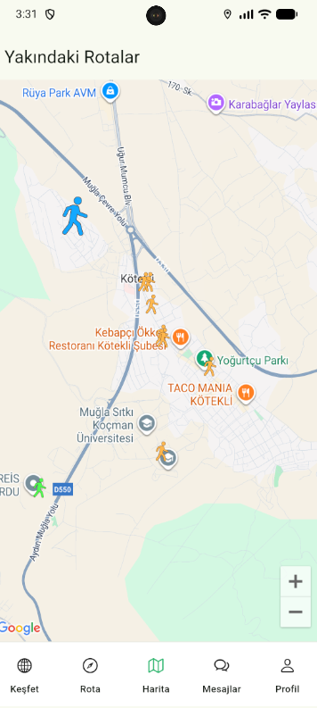
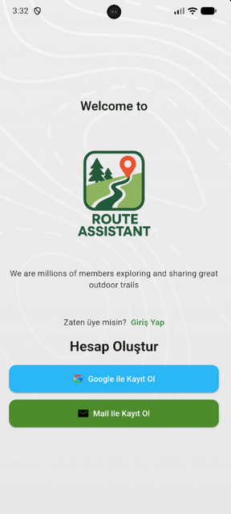
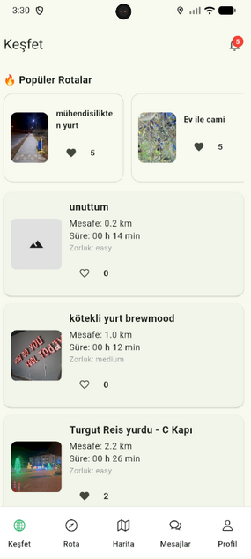
ROUTE ASSISTANT
MOBILE ROUTE DISCOVERY & SHARING APPLICATION
Ömer Faruk Kaba - 220717044
Esra Yıldız - 220717015

Slide 2



WHAT IS ROUTE ASSISTANT?
A mobile application for discovering and sharing outdoor routes
Users can create, view, and explore routes on an interactive map
Community-based platform with profiles, comments, and messaging
Designed for hiking, cycling, and outdoor activities

Slide 3
PROBLEM DEFINITION
WHY ROUTE ASSISTANT?
Route Assistant addresses common challenges in outdoor navigation by providing detailed route information and enabling users to share their own experiences through a community-driven platform.
01.
02.
03.
04.
Difficulty in finding reliable and well-described outdoor routes
Limited route details such as distance, difficulty, and user feedback
Existing applications lack strong community interaction
Users cannot easily share their own routes

Slide 4

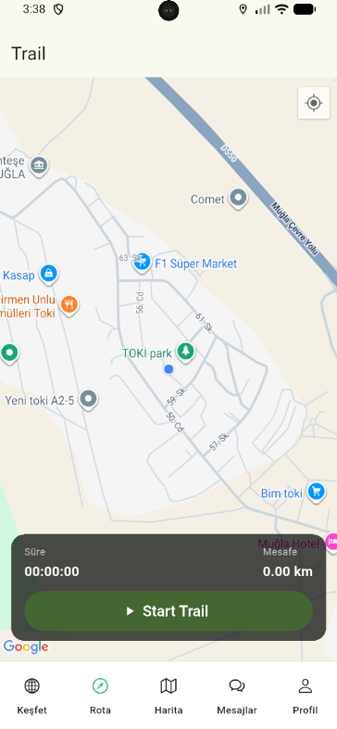
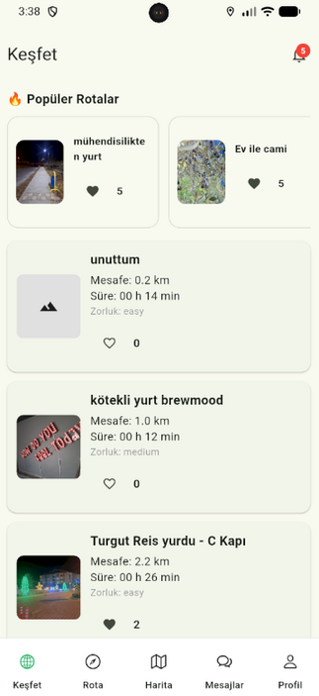
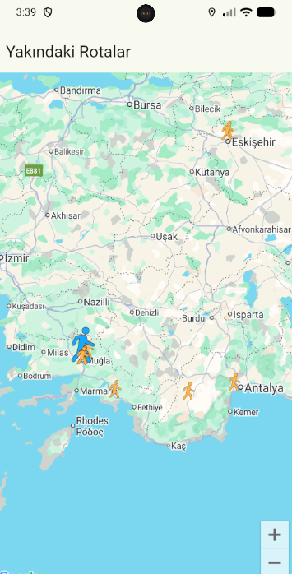

PROJECT AIM & OBJECTIVES
EASY TO USE
EFFICIENT ROUTE MANAGEMENT
Route Assistant offers a simple and intuitive interface that allows users to explore and create routes with minimal effort.
The application enables users to easily create, manage, and share routes through an interactive map system.
ACCESSIBLE ANYTIME
COMMUNITY DRIVEN
Users can access route information and explore maps anytime, making outdoor planning more convenient and flexible.
Route Assistant encourages user interaction by allowing comments, profiles, and shared experiences within the platform.

Slide 5


TARGET USERS
HIKERS
Users who enjoy hiking and nature walks and need reliable route information.
CYCLISTS
Cyclists looking for suitable routes with distance and difficulty details.
OUTDOOR ENTHUSIASTS
People who enjoy outdoor activities and discovering new places.
AMATEUR EXPLORERS
Users who want to explore unfamiliar routes safely and efficiently.

Slide 6




CORE FEATURES
ROUTE CREATION & EXPLORATION
Users can create and save their own routes using the map interface and explore available routes with detailed information and map visualization.
USER AUTHENTICATION
Authentication is handled securely to protect user identities and application data.
COMMUNITY SUPPORT
User profiles, comments, and messaging for community engagement.

Slide 7
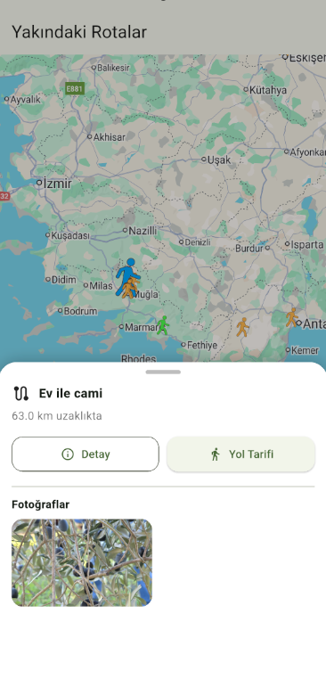
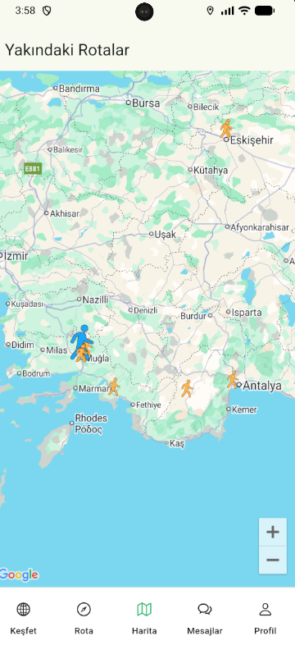
TECHNOLOGIES USED
FLUTTER
Used for cross-platform mobile application development with a single codebase.
SUPABASE
Backend service for authentication, database management, and real-time features.
GOOGLE MAPS SDK
Provides map visualization, location services, and route display.
POSTGRESQL
Used as the relational database to store users, routes, and related data.

Slide 8
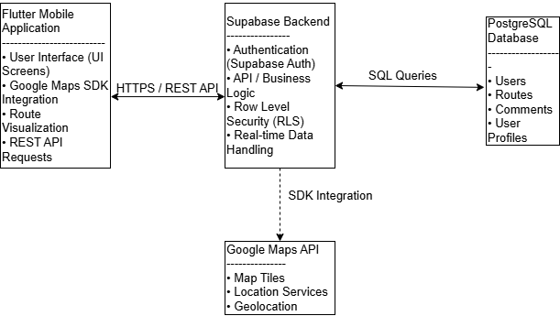
SYSTEM ARCHITECTURE

Slide 9
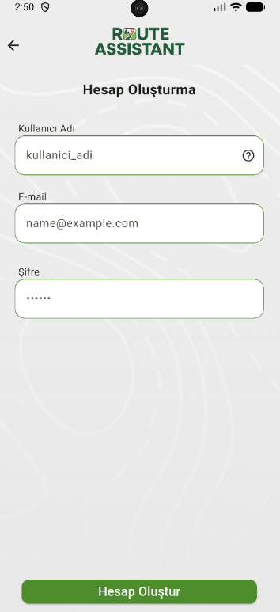
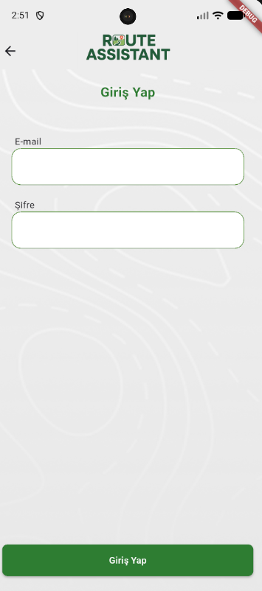
APPLICATION SCREENS
LOGIN & REGISTER
Provides secure user authentication using email and password.
Includes user registration, login validation, and session management to ensure safe access to the application.

Slide 10
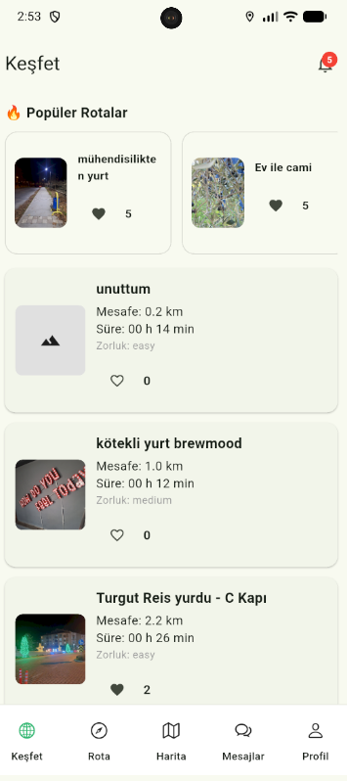
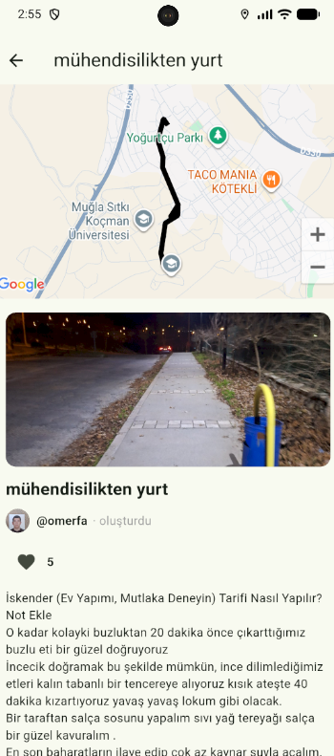
APPLICATION SCREENS
EXPLORE / HOME
Displays available routes on an interactive map and list view.
Users can browse routes, view basic details, and select a route to see more information.
ROUTE DETAIL
Displays comprehensive information about a selected route, including an interactive map, route description, distance details, and user comments.

Slide 11
APPLICATION SCREENS
TRAIL SCREEN
Displays routes created by the user and saved trails.
Users can manage their own routes and quickly access previously explored paths.
MAP SCREEN
Shows routes near the user’s current location using real-time map data.
Allows users to discover nearby routes easily and quickly.

Slide 12
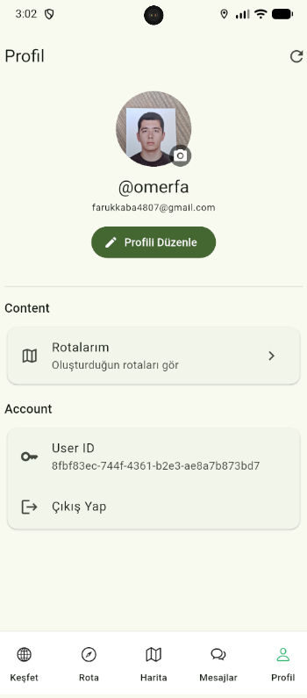
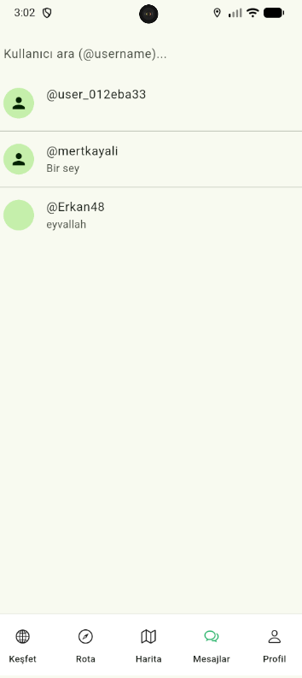
APPLICATION SCREENS
PROFILE SCREEN
Allows users to manage their personal information and view their created routes.
Users can update profile details and monitor their activity within the application.
MESSAGE SCREEN
Enables real-time communication between users within the platform.
Users can exchange messages related to routes and outdoor activities.

Slide 13
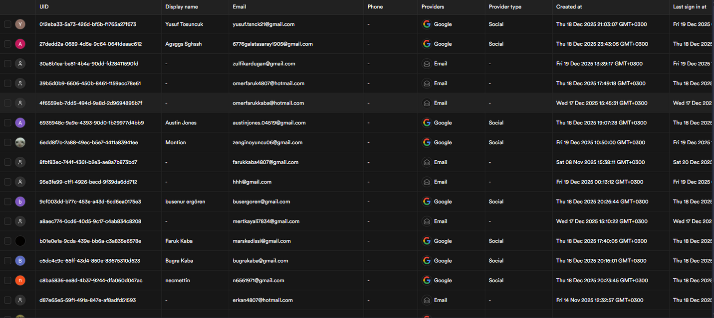
TESTING & PERFORMANCE
TESTED BY REAL USERS

Slide 14

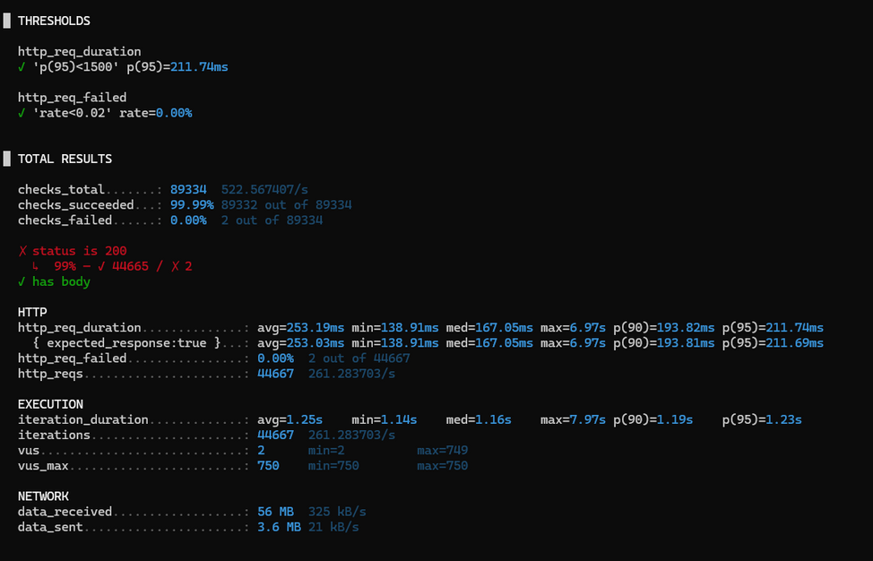
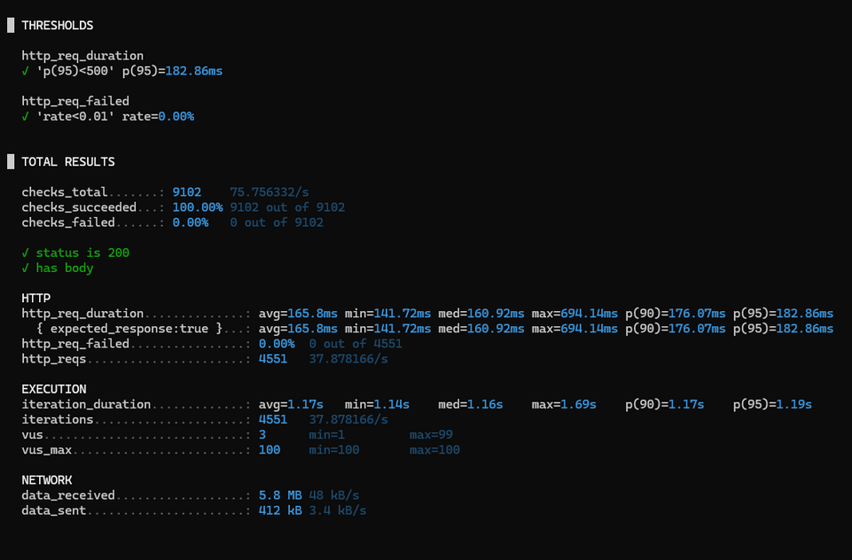
TESTING & PERFORMANCE
LOW LOAD RESULT
MEDIUM LOAD RESULT

Slide 15
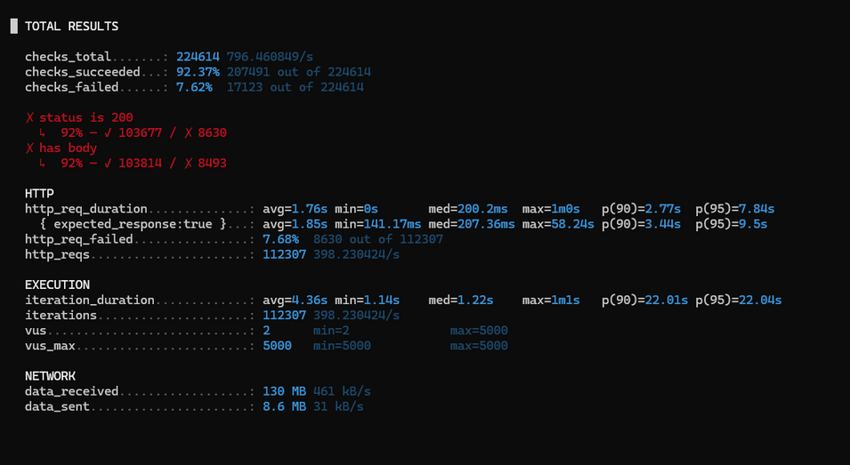
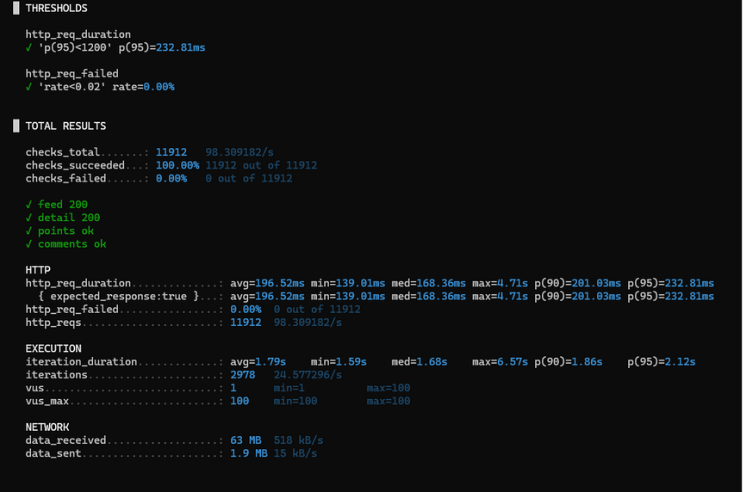
TESTING & PERFORMANCE
HIGH LOAD RESULT
USER-BASED TESTING

Slide 16
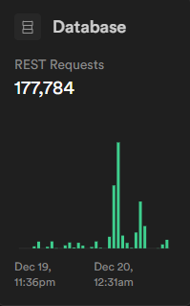
TESTING & PERFORMANCE
OBSERVED METRICS
PERFORMANCE INTERPRETATION
Total REST requests: 177,784
Requests generated during testing and real user usage
Stable request handling without service interruption
The backend successfully handled a high number of requests
No unexpected downtime observed during testing
System performance remained stable under realistic usage scenarios
CONCLUSION
The testing results indicate that Route Assistant’s backend is capable of handling real-world usage with stable performance and acceptable response times

Slide 17
FINAL CONCLUSION
Route Assistant successfully achieved its initial project objectives
A fully functional mobile application was developed using modern technologies
Core features such as route discovery, sharing, and user interaction were implemented
Backend performance and reliability were validated through testing
The project demonstrates practical mobile development and backend integration skills

